Slide 1
CPE 133
Accumulators & Event Counters
Shift Registers
Example Problems
Experiment #13

Slide 2
Accumulators
Adds list of numbers
You can only add two items at a time
Adds current value to running total
You must properly specify sum bit-width

Slide 3
Event Counters
Special case of accumulator
If you’re always accumulating a ‘1’, use the incrementing feature of a counter (UP)
Could be useful in a parity checking circuit…

Slide 4
Shift Registers
Shift Registers
Special case of registers
Massively useful (Do Examples)
Fast binary multiplication
Fast binary division

Slide 5
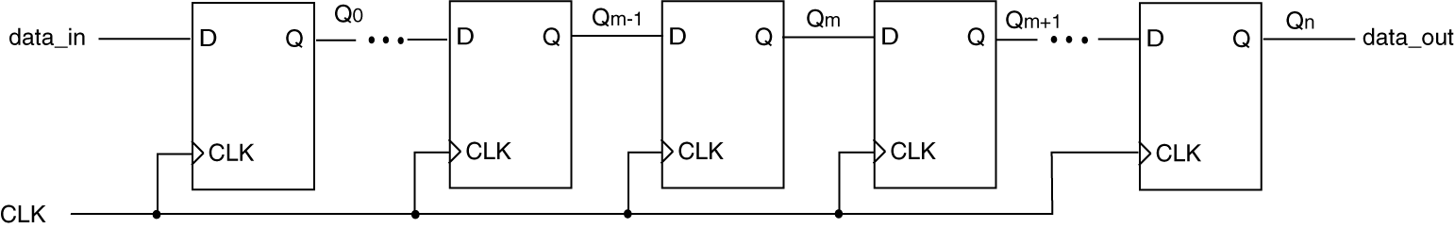
Shift Register: General Case
N-bit shift register
Features
All 1-bit registers share same clock
n-bits of data shift right simultaneously
Left-most bit input from “outside world”
Right-most bit shifts out to “somewhere”

Slide 6
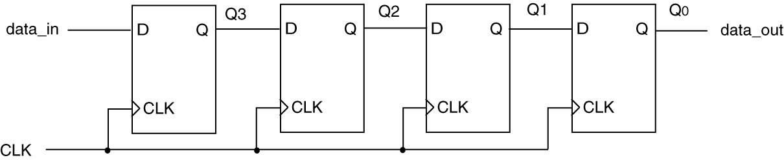
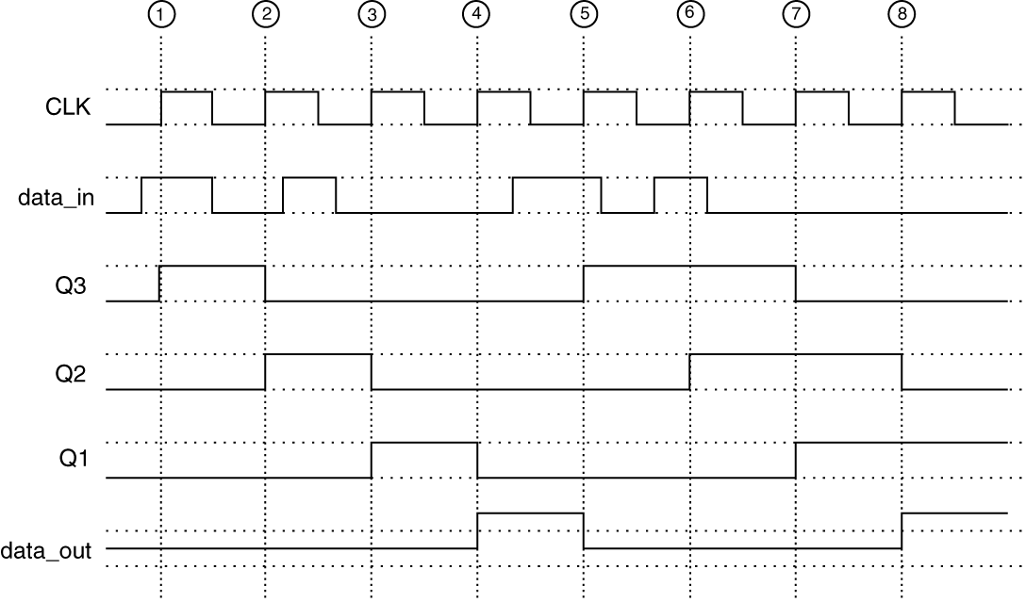
4-Bit Shift Register Example

Slide 7
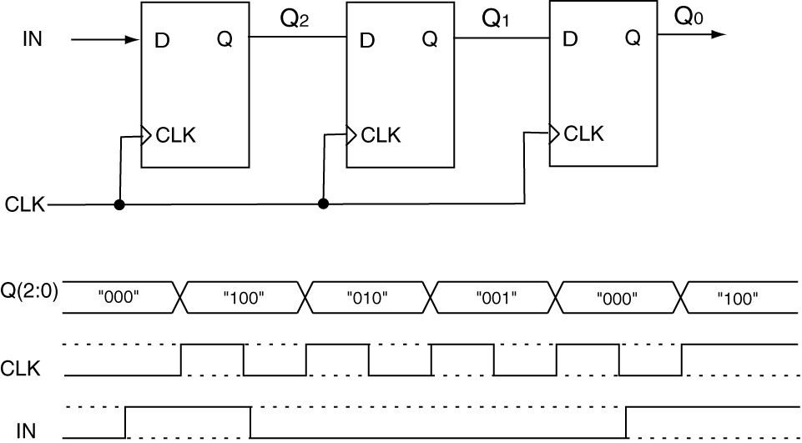
3-Bit Shift Register (right)
Sample Timing Diagram: 3-bit Shift Register

Slide 8
Foundation Module Notation
For provided USR Module, x=2

Slide 9
module usr_nb(data_in, dbit, sel, clk, clr, data_out);
input [n-1:0] data_in;
input dbit, clk, clr;
input [1:0] sel;
output reg [n-1:0] data_out;
parameter n = 8;
always @(posedge clr, posedge clk)
begin
if (clr == 1) // asynch reset
data_out <= 0;
else
case (sel)
0: data_out <= data_out; //- hold value
1: data_out <= data_in; //- load
2: data_out <= {data_out[n-2:0],dbit}; //- shift left
3: data_out <= {dbit,data_out[n-1:1]}; //- shift right
default data_out <= 0;
endcase
end
endmodule

Slide 10
Design Problem #1:
Design a circuit that upon a button press, divides an 8-bit unsigned binary input values by two for as many times as required to make the result of the input value less than 17. The result of this operation is also an 8-bit unsigned binary number.
Consider the output persistent
Show a BBD of your solution
Minimize hardware in your solution
State what type of control the circuit has

Slide 11
Design Problem #2:
Design a circuit that outputs a value 5.5 times greater than the input value upon the pressing of a button.
Assume the input “stays around” for awhile
Assume the input is an 8-bit unsigned binary value and the width of the output is minimized but the answer is valid and persistent.
Show a BBD of your solution
Minimize hardware in your solution (use no more than one RCA in your design)
State what type of control the circuit has

Slide 12
Experiment 13: Serial Parity Generator
Upon button press, circuit calculates parity associated with 16 dev board switches
Display
Two 7-seg digits: “EE” or “oo” (even & odd parity)
Two 7-seg digits: count of switches that are “on”
Use FSM in design
Use display multiplexor from Exp 12 (with mods)

